Slide 1
Union Manpower Services

Slide 2
Company’s Overview
Union Manpower Services is -–
- In the business successfully for around 20 years
- Operating offices in 10 cities covering entire Pakistan
- Associated with National Training Bureau across Pakistan
- A highly preferred recruiter with Pakistan’s largest job portals www.rozee.pk, www.bayrozgar.com and Express Group
- Registered with Ministry of Labor and Saudi Consulate
- ISO 9001-2008 certified for Quality Management System

Slide 3
Union Trade Test & Training Centre (UTTC)
UTTC is among the largest chain of MEP, Civil, Electro-Mechanical and Facility Management Test and Training centre in 9 notable cities of Pakistan. Also working in association with National Training Bureau.

Slide 4
Our Presence
1. Rawalpindi 2. Islamabad
3. Lahore 4. Karachi
5. Kashmir 6. Sahiwal
7. Samundri 8. Layyah
9. Toba Tek Singh 10. Dunyapur

Slide 5
We have Dropbox

Slide 34
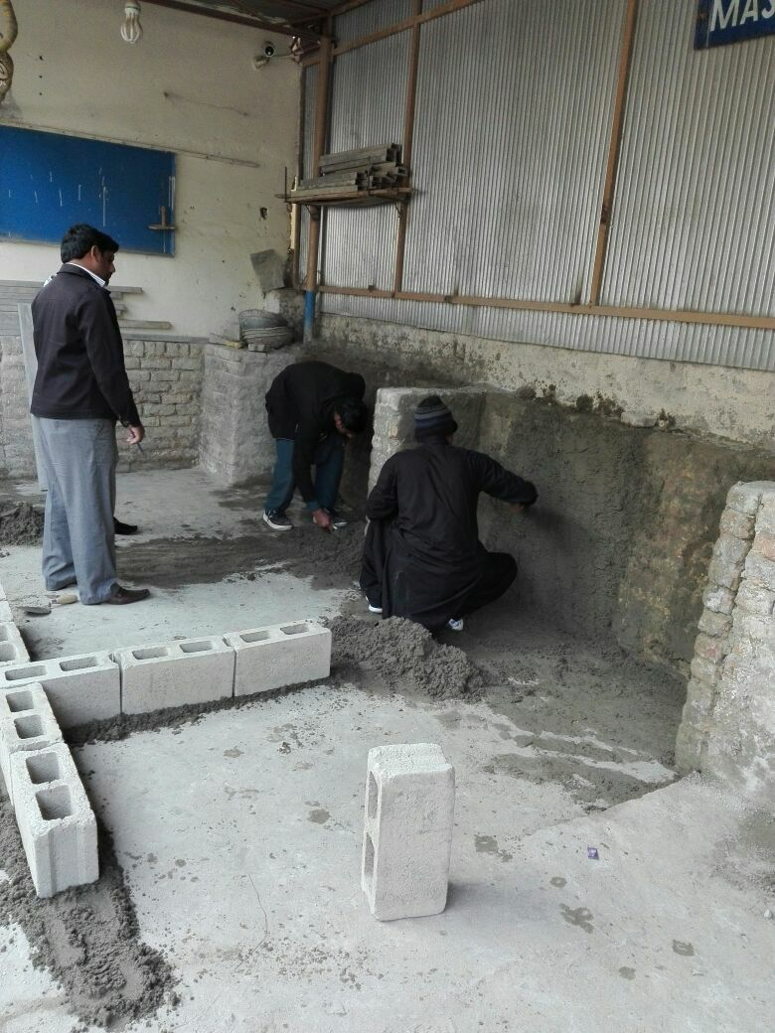

Slide 56
Thank You!

